Slide 1
Human Machine Interface development and vulnerabilities in SCADA systems
CSC 6222
Wasfi Momen
April 18, 2018

Slide 2
Introduction
SCADA (Supervisory Control and Data Acquisition) is an architecture of various computers to control industrial processes.
  RTU (Remote Terminal Unit)
  PLC (Programmable Logic Controller)
HMI (Human Machine Interfaces) are how
  control operators, plant engineers, site managers (OT)
  software developers, system administrators, red team cybersecurity (IT)
interact with the elements of SCADA infrastructure.

Slide 3
So why should you worry about SCADA?

Slide 4
So why should you worry about SCADA?
You’re in one!

Slide 5
Disclaimer:
Information from 2006 ASUR report. Since then, GSU has updated services.
GSU SCADA

Slide 6
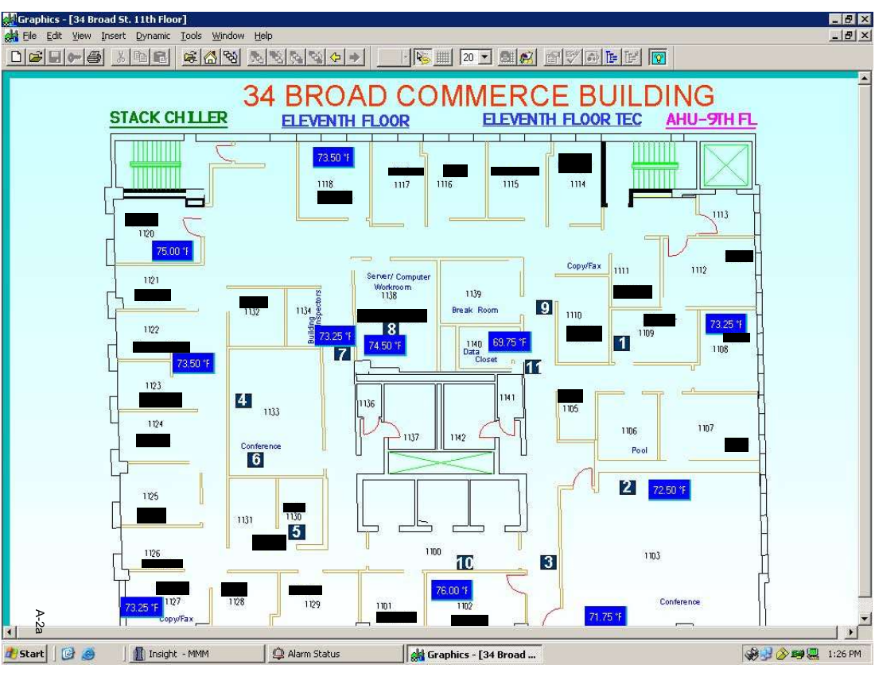

Slide 7
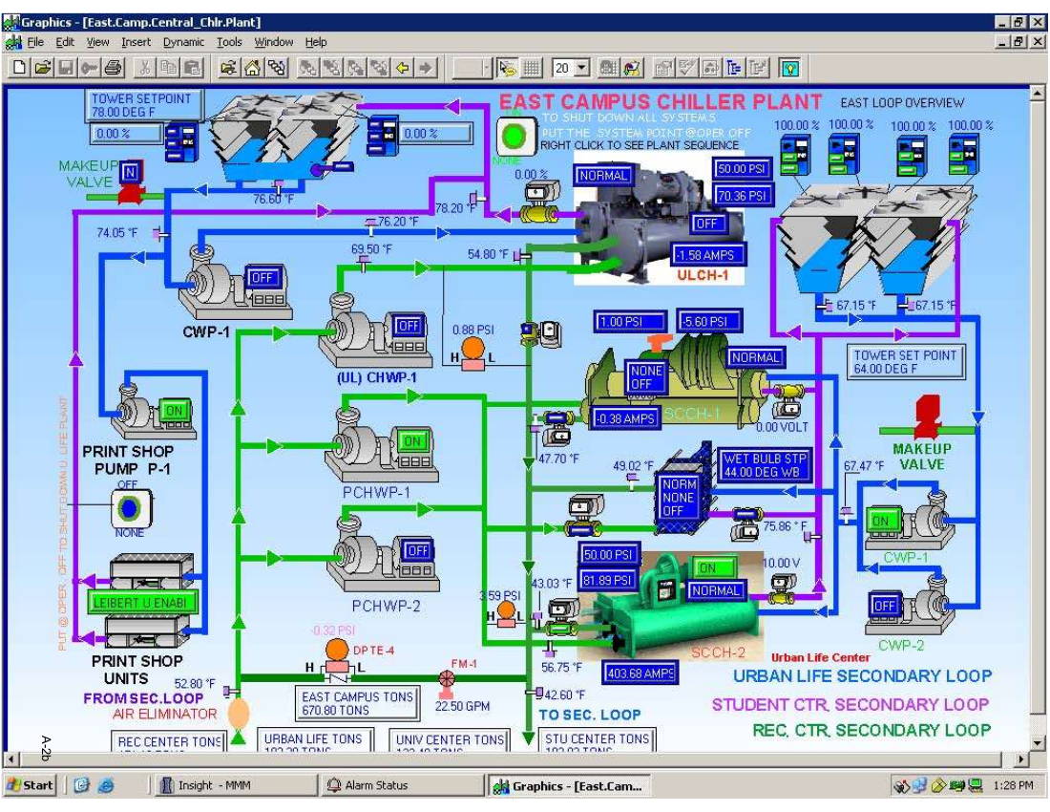

Slide 8
Overview of SCADA security
SCADA has gone through generations
  Monolithic -> Distributed -> Networked -> IoT
Their hardware and software developed on both sides of IT and OT
  New user interfaces, new servers for SCADA purposes, new PC hardware
  New PLCs, new engineering developments, new techniques
SCADA control feedback now has more computers and attack surfaces.
  60% of attack vectors in 2015 were web applications. In 2017, HTTP was the most attacked protocol in SCADA.
  Now, most common attacks in SCADA are software applications, not airgapped networks.

Slide 9
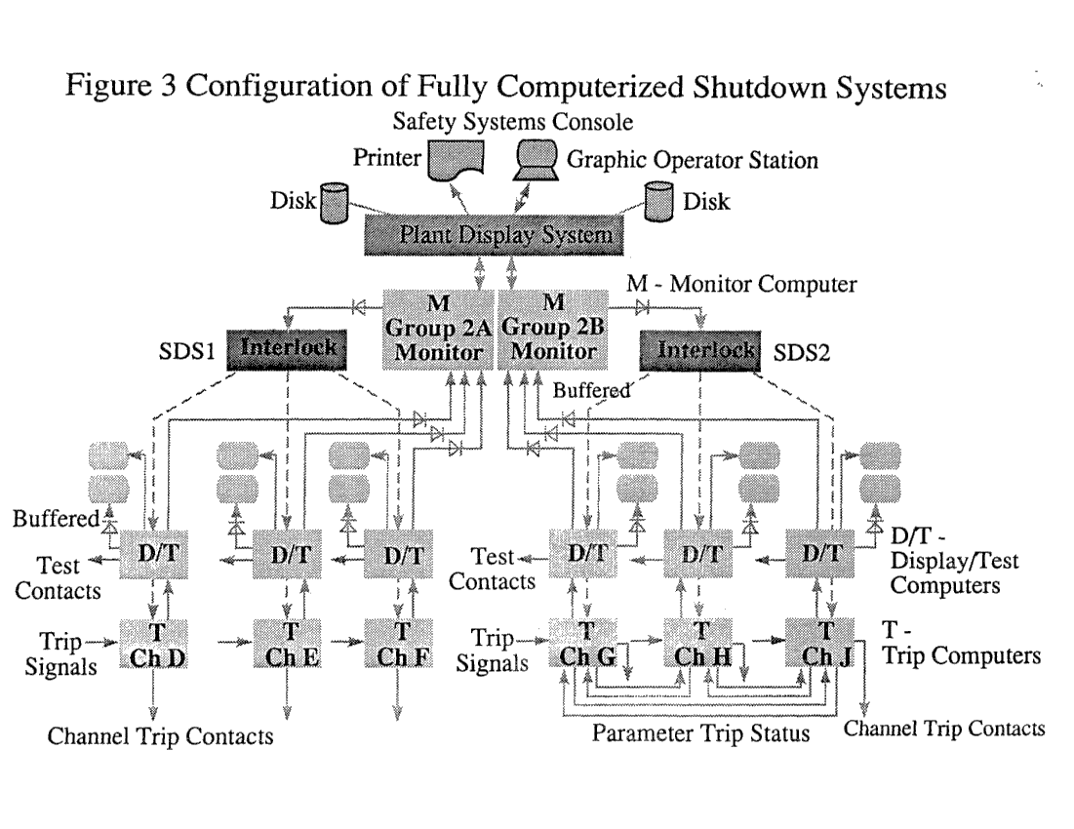
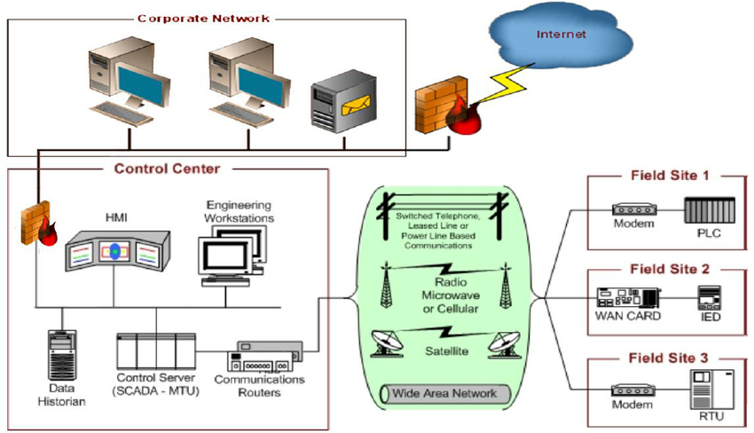

Slide 10
Research of SCADA vulnerabilities
Research focus on the network aspects of SCADA
  Vulnerable protocols: BACnet, Modbus
  Stronger cryptography by updating hardware and software with better key strengths. Only algorithm development is with American Gas Assocation.
  Network models for firewalls and penetration testing
Industry responds with implementations in hardware and software
  Long development and release lifecycle; The Purdue Model
  Using more security protocols like AES-CCMP instead of AES-TKIP
  Reduce connections to physical processes and devices since protocols aren’t secure: DNP3, Modbus, BACnet
Organizations and Standards
  NIST, ISA 95/99, FIPS, ASME, ICS-CERT, ISO/IEC

Slide 11
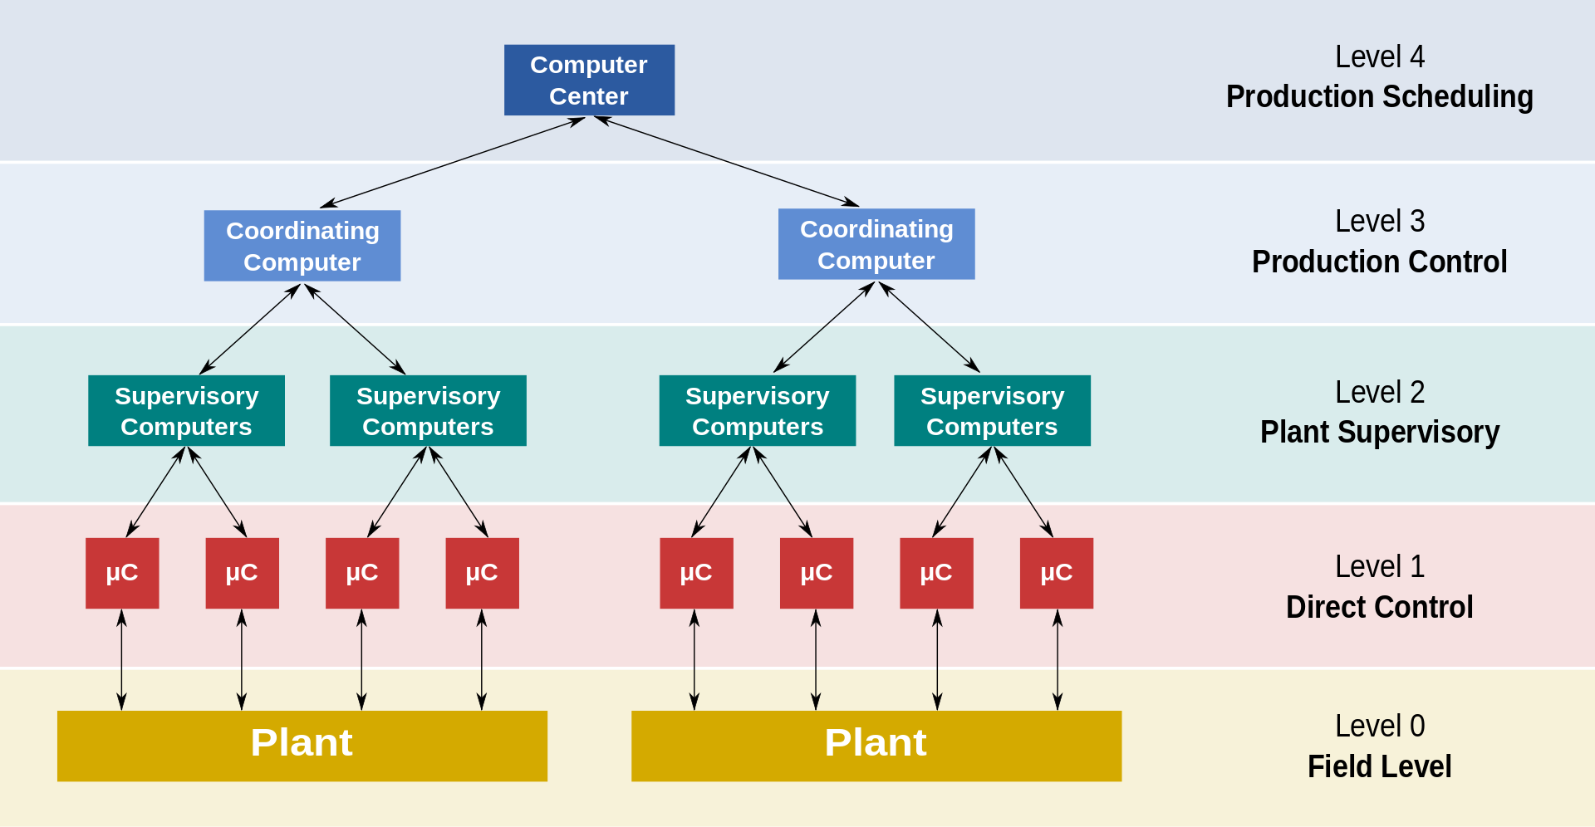
The Purdue Model (1990s)

Slide 12
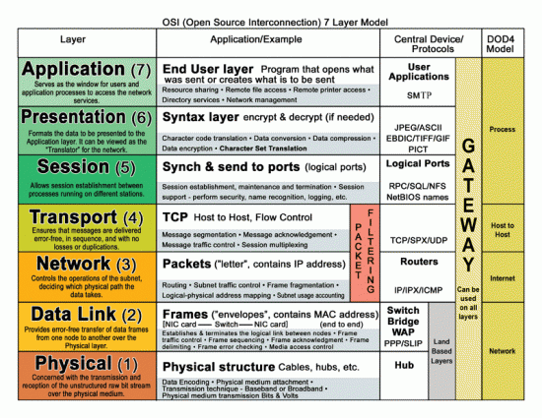
The OSI Model (1984)

Slide 13
…But web security is overlooked
Little to no references of HMI vulnerabilities either on IT/OT or in papers.
NIST and ICS mention securing web servers, but not the applications running the HMI.
Good practices for web security are left to the company building your SCADA package or to the team managing the facility.
  Who develop their own checks for their own products
  Who practice “security through obscurity”
  Who don’t have open standards because their gov’t doesn’t make them have it (why else do you think slide 9 had a Canadian reactor design?)

Slide 14
Project Purpose
Develop or simulate HMI to test various webapp attacks and see if current SCADA monitoring tools report on attacks.
Use persistent XSS, Data sanitization, Data Object Model corruption (not only in html but other objects like Windows Server Objects)
Use Conpot, the virtualized SCADA honeypot that simulates devices and systems.
Not targeting passwords or authentication vulnerabilities.
Target PLC: SIMATIC PLC-1200 or lower by Siemens.
Monitoring tools: SNORT, Splunk, and, if possible, Mantis.

Slide 15
Approach
Intel scouting
  Software
    Looked up Siemens codebase based on the “WinCC User Days” slides from May 2017.
    Their HMI is called WinCC OA (“Open” Architecture) to SCADA systems for monitoring and executing.
    Current version at 3.15. Uses Angular, d3.js, NoSQL, Windows Server 2016.
    Just passed OPC UA it seems, so next User Days are coming soon.
  Hardware
    Siemens has a catalog of all products for any industry
    TIA Portal is a shopping portal that allows for users to custom build their own SCADA hardware setup. Can export to XML for use in simulations and actually integrates with their own WinCC OA HMI.

Slide 16
Approach (cont.)
Siemens develops their website and HMI with the same technology.
  Wincc V7 used ASP.net and their website is still with aspNet classes to serve the webpage.
  Siemen’s product shop TIA Portal uses Angular and offline tool uses Qt, the same tech for their screens on devices.
Therefore, it is reasonable to assume and build a similar HMI application for attacks and see their resulting violations.

Slide 17
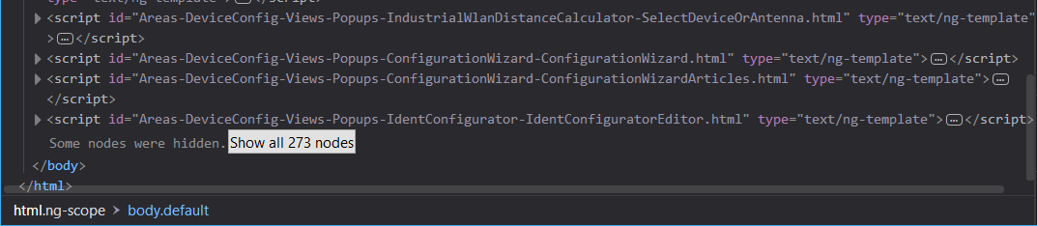
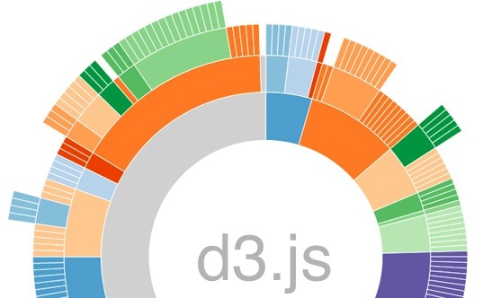
Siemens HMI Attack Space

Slide 18
Anticipated Problems
Right now, I’m developing the Angular application to model my HMI for Conpot. Siemens doesn’t provide their HMI to just anyone.
Even with Conpot, the data historian and logging needs an HTTP proxy server.
  Most SCADA packages include this since it is necessary for controlling feedback to devices.
  Making a historian can introduce caching attacks from the webapp, so it is a primary attack vector relevant to SCADA HMI that we might not be able to reproduce at this time.
But the whole point is seeing if the monitoring holds up and can detect malicious activity within the webapp.

Slide 19
Anticipated Results
Conpot will be using Splunk and Amazon services to try to recreate SCADA setup.
Want to see SNORT and Splunk report HTTP requests
  Other papers use nmap to port scan the device’s Modbus and therefore trigger an alarm
  We want to use the webapp itself to see if it goes through the device’s Modbus and trigger an alarm
Alarms can be configured for a variety of situations, but what if the situation isn’t a cause for alarm?
  Case: Heavy Water Reactor Inspection

Slide 20
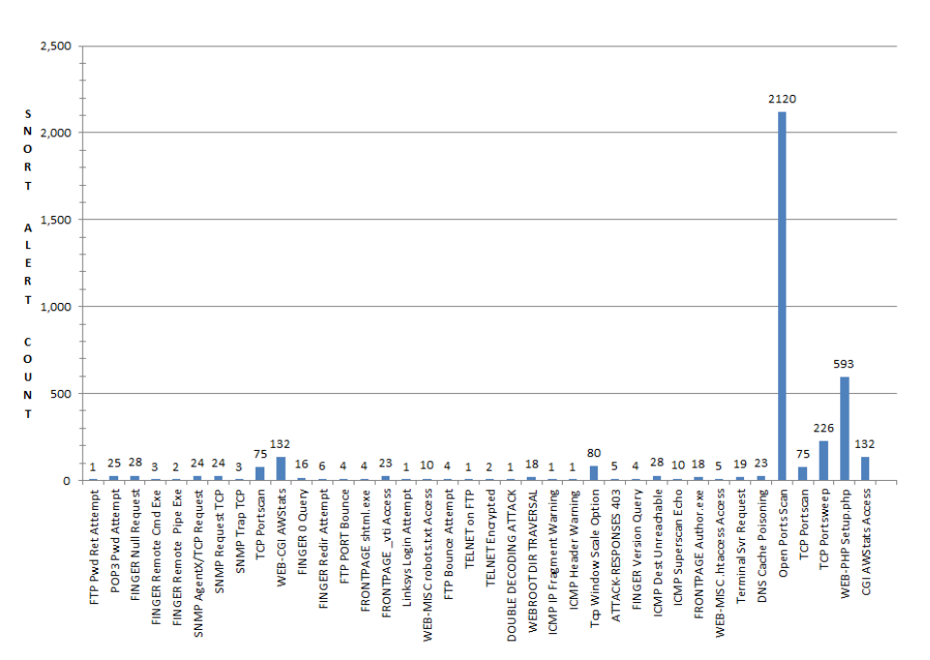
Instead of port scan, either stay silent or violate a tcp or udp port

Slide 21
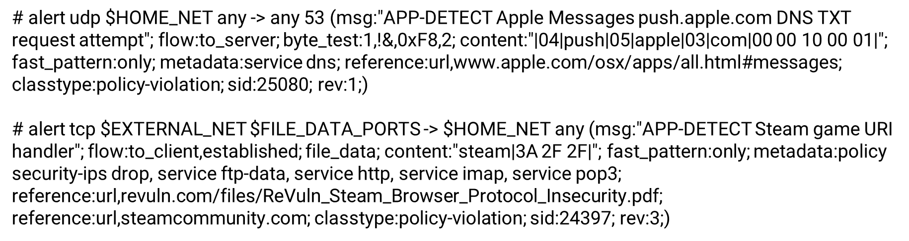
Example SNORT alert config
Source: https://github.com/John-Lin/docker-snort

Slide 22
What I’ve learned…so far
There has been a lot of development, research, and standardization for SCADA network infrastructure. But there are some aspects that need to be polished.
There are available tools now for anyone to set up and simulate a SCADA system. We’ve jumped over the problem of hardware and networks, but now need to focus on the software.
Bridging the IT/OT gap will need to be not just updating software or add new features, but including users in the software development lifecycle that can run faster than product development.
This is probably a good master’s project idea.

Slide 23
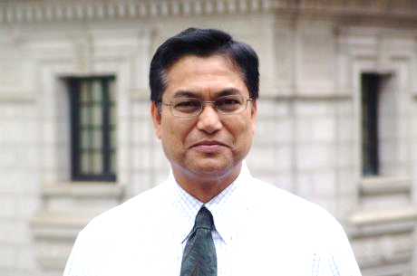
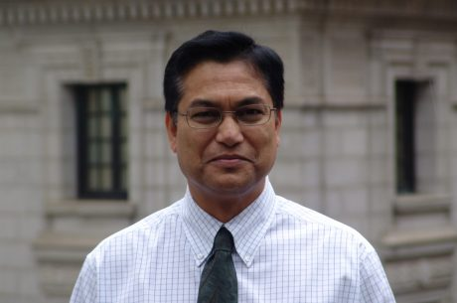
Acknowledgements: Bridging IT and OT
Abdul Momen
Director of Maintenance & Operations, GSU
Masuma Momen
Analysis Programmer Intermediate,
GSU

Slide 24
References

Slide 25
Q&A?

